Slide 1

Internship Project
TITLE PAGE
Problem Statement : Health Insurance Cost Prediction
Domain : Data Analytics and Machine Learning Approach
Team Members:
Kartiki Pansare (4618)
Sakshi Shinde (4646)
Snehal Sonawane (4650)
Sayali Sonule (4652)

Slide 2
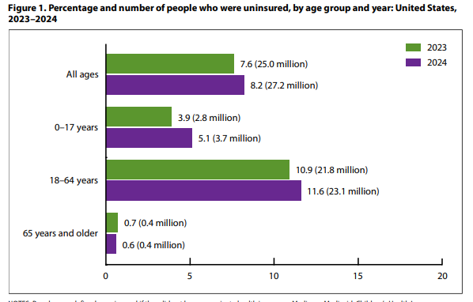
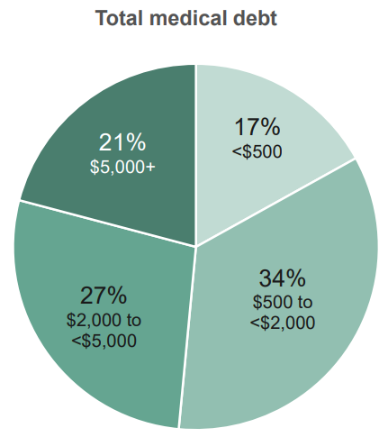
MOTIVATION
Motivation:
30% of Americans delay or avoid health insurance due to cost uncertainty
Lifestyle factors (smoking, obesity) can increase premiums by 50-200%
No tool shows how health changes reduce costs before applying
Existing Systems:
Insurance Calculators (Oscar, Kaiser, UnitedHealthcare) - Basic quotes, no health recommendations
Healthcare.gov - Premium costs, no health impact predictions
Health Risk Tools (WebMD, Mayo Clinic) - Disease risk, no cost connection
Our Differentiators:
All-in-One: Combines cost prediction + health assessment + savings recommendations
Dynamic Predictions: Shows how lifestyle changes affect future costs
Privacy-First: Only 6 anonymous metrics (no name, email, SSN)

Slide 3
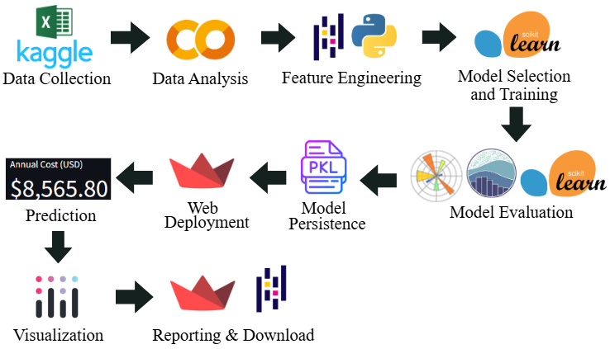
STEPS
1. Data Collection & Analysis (Kaggle, Excel, Google Colab / Jupyter Notebook): Gather historical insurance data, clean it, handle missing values, and explore patterns
(Kaggle Dataset Obtained from Book : "Machine Learning with R", by Brett Lanz)
2. Feature Engineering (Python / Pandas): Encode categorical variables and create new features if needed
3. Model Selection & Training (Scikit-learn): Choose suitable ML algorithm and train the model on historical data
FIG: System Architecture

Slide 4





Model Evaluation (Matplotlib, Seaborn, Scikit-learn): Validate model performance using
metrics like MAE, RMSE, R² and visualize errors
Model Persistence (Pickle .pkl): Save the trained model for future use without retraining
Web Deployment & Prediction (Streamlit / app.py, Streamlit UI, Plotly): Build interactive app, take user input, predict insurance cost, and display results
Reporting & Download (Streamlit, Pandas): Generate downloadable summaries or reports for users
Project Implementation & Deployment Flow (With Links):
Kaggle Dataset
Model Training & Analysis (.ipynb)
Trained Model (.pkl)
app.py & requirements.txt (GitHub)
Deploy via Streamlit (GitHub Integration)

Slide 5
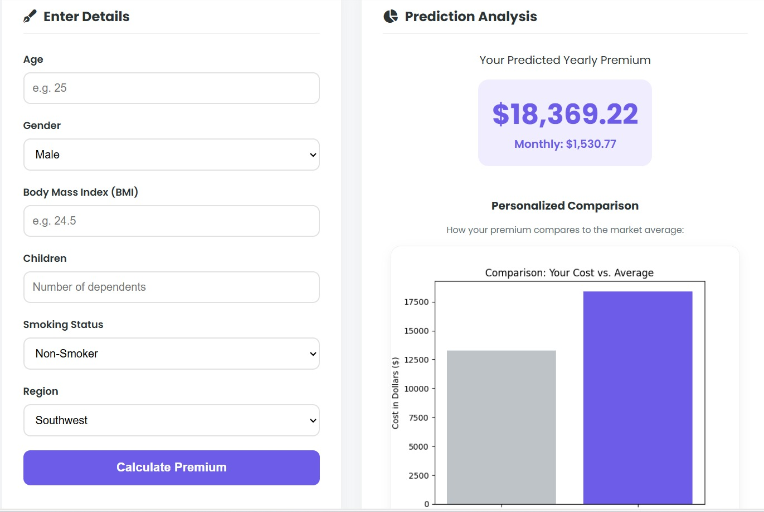
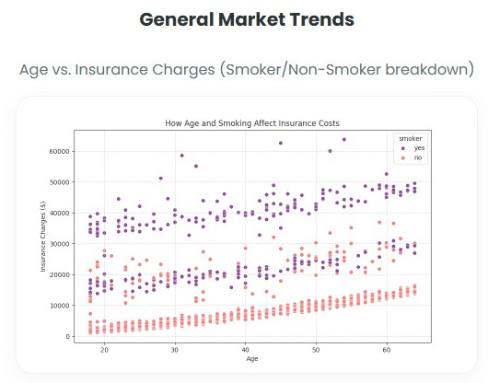
RESULT
Performance of Gradient Boosting Regressor
MAE ≈ 2410
RMSE ≈ 4314
R² Score ≈ 0.88
Random Forest Regressor:
MAE ≈ 2,550 - 2,800
RMSE ≈ 4,500 - 4,800
R² Score ≈ 0.85 - 0.86
Linear Regression:
MAE ≈ 4,200 - 4,500
RMSE ≈ 6,000 - 6,500
R² Score ≈ 0.75 - 0.78
Result
Gradient Boosting performed better than Linear Regression
Captures complex and non-linear relationships
Accurate insurance cost prediction
Fast and automated estimation
Future Scope
1. Indian Dataset Integration - Adapt to Indian insurance patterns and demographics
2. Live Health Tracking - Real-time cost updates as health improves
3. Insurer Partnerships - Direct plan comparison and policy purchase
FIG: Flask Deployment

